Slide 1

Term Project Teknosa Website Testing
1
Lecture:
SE2226-Software Quality Assurance and Testing
Students Name-ID:
Ahmet Kemal Biliciler-21070006001
Ozan Böce -21070006020
Cavit Utku Tipici- 21070006043
Department:
Software Engineering
Lecturer:
Korhan KARABULUT

Slide 2

INTRODUCTION
2
Teknosa is one of the Turkey’s leading e-commerce platforms . Teknosa is a platform that offers a wide range of products in the online shopping sector serving millions of users.
The Teknosa website was established on January 26 , 2013, and been actively operating since then.

Slide 3
INTRODUCTION/ OUTLINE
BLACKBOX TESTING
3
Use Case Testing
Decision Table
Boundary Value Analysis
Load Testing

Slide 4
INTRODUCTION/ OUTLINE
WHITEBOXTESTING
4
Usability Testing
Unit Testing
Selenium WebDriver

Slide 5
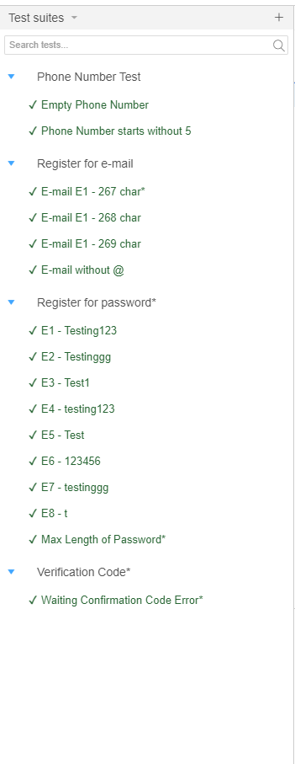
Testing For Registration Part
5
Executed Texts :
Phone Number Test
E-mail Test
Password Test
Invalid Verification Test
Decision Table for Password
Boundary Value Analysis for E-mail

Slide 6
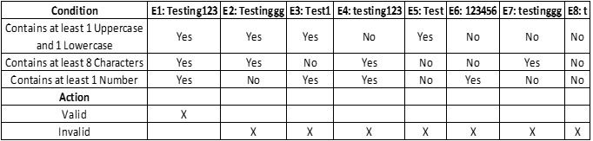
6
Decision Table For Password In Registration Part

Slide 7
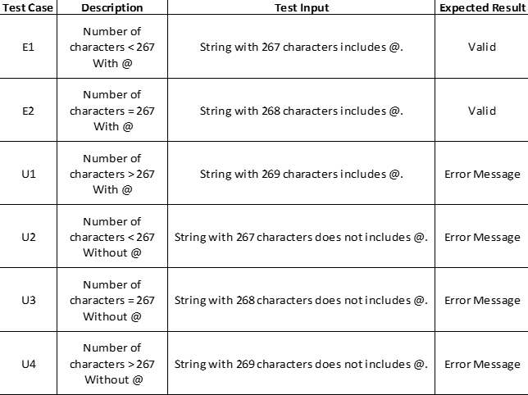
7
Boundary Value Analysis For The E-mail

Slide 8
8
Load Testing Summary Results
Number of Threads : 1000 users
Ramp-up Periods : 10 sec
Throughput : This is the number of request per second that were processed during the test
Std.Dev : This stands for Standard Deviation, which measures the variability or dispersion of the response times. A higher standard deviation indicates more variability.

Slide 9
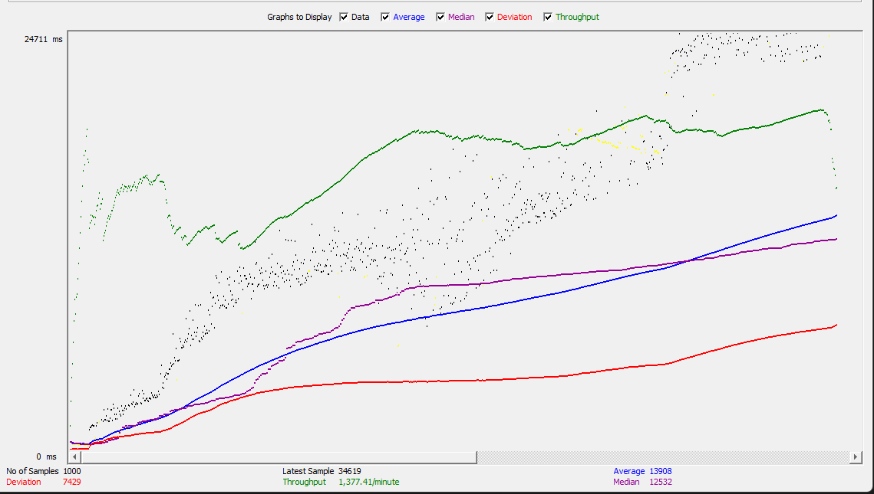
9
Load Testing Graph Result
Data
Average
Median
Duration
Throughput

Slide 10

10
Automated Shopping Cart Test
This test controls adding the same product number of max quantity to the shopping cart.
(for boundary value analysis)

Slide 11
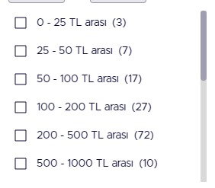
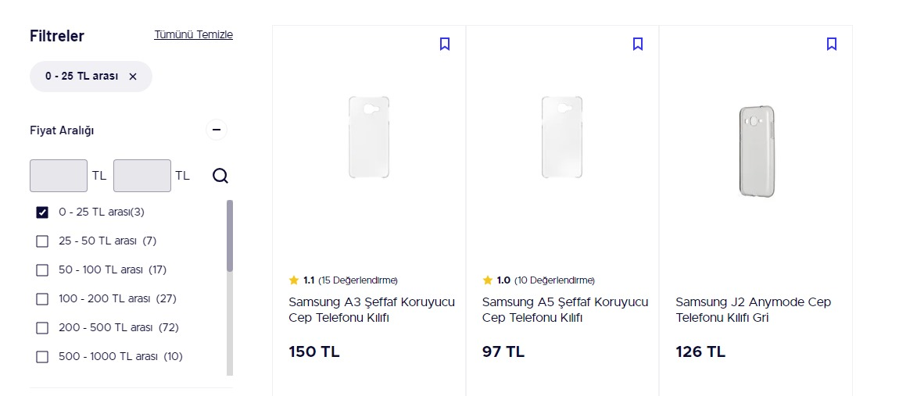
11
Automated Price Range Checking Test

Slide 12
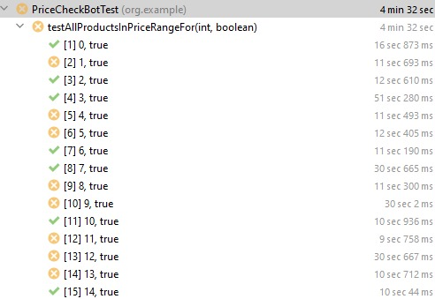
12
Automated Price Range Checking Test
This test controls are the items in the chosen price range.
Out of 15 tests, 8 tests failed.
46.67% Success Rate
(indexes refers to checkbox id’s)

Slide 13

13
Total Price In Shopping Cart Checking Test
This test checks whether the total price is equal to the sum of the prices of all items in the cart.

Slide 14
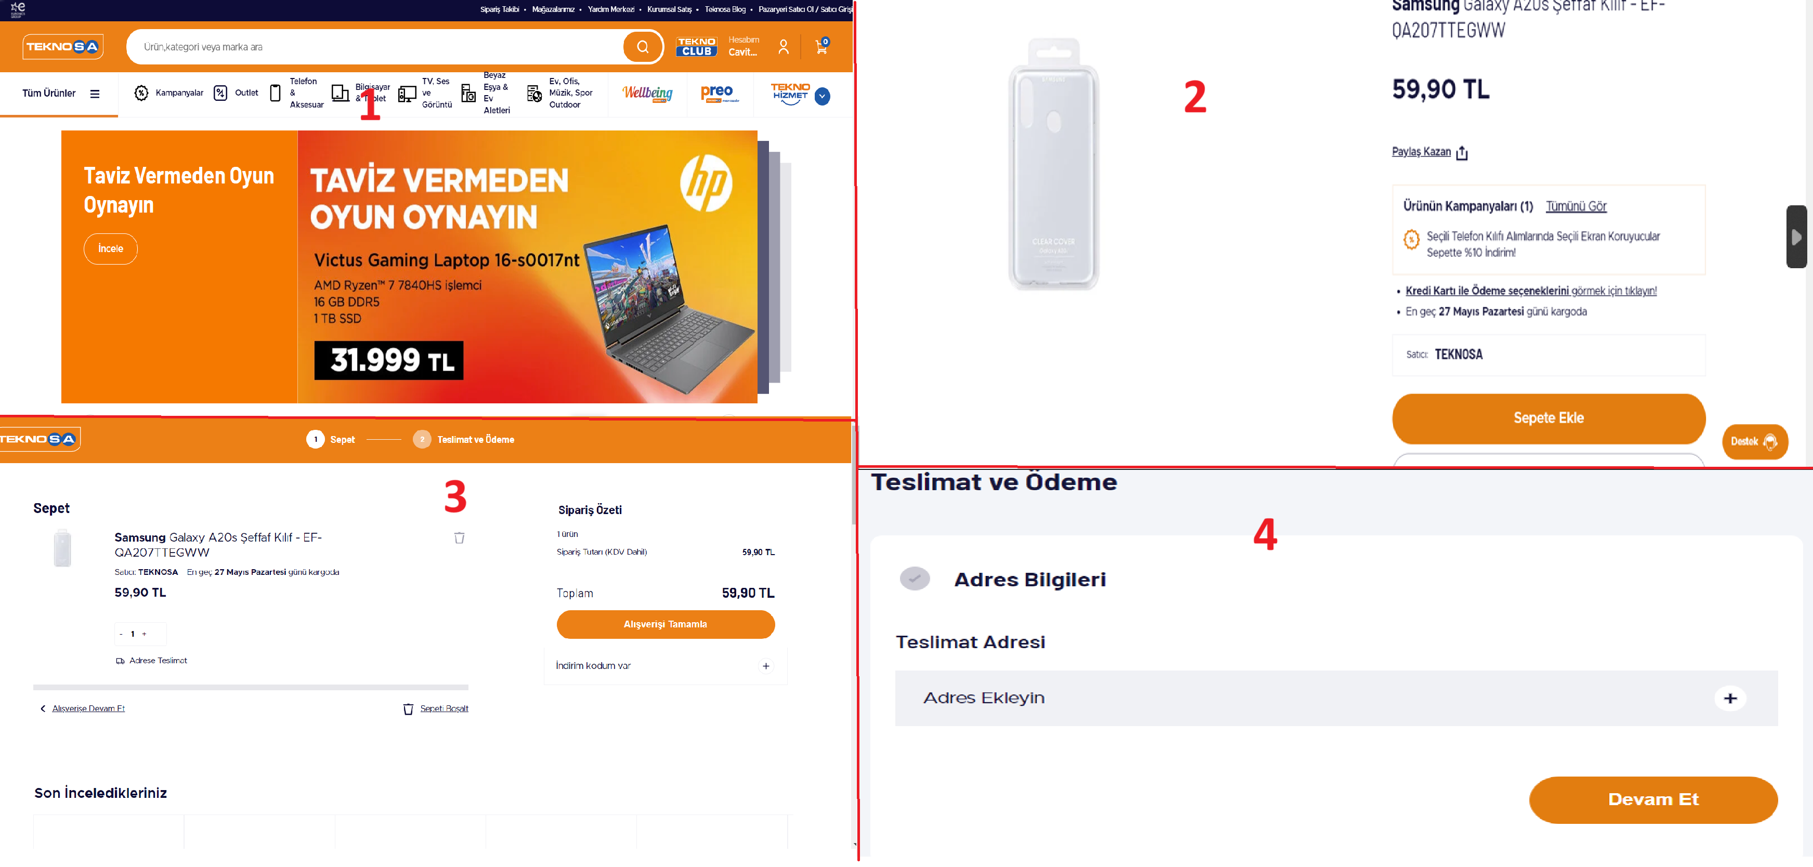
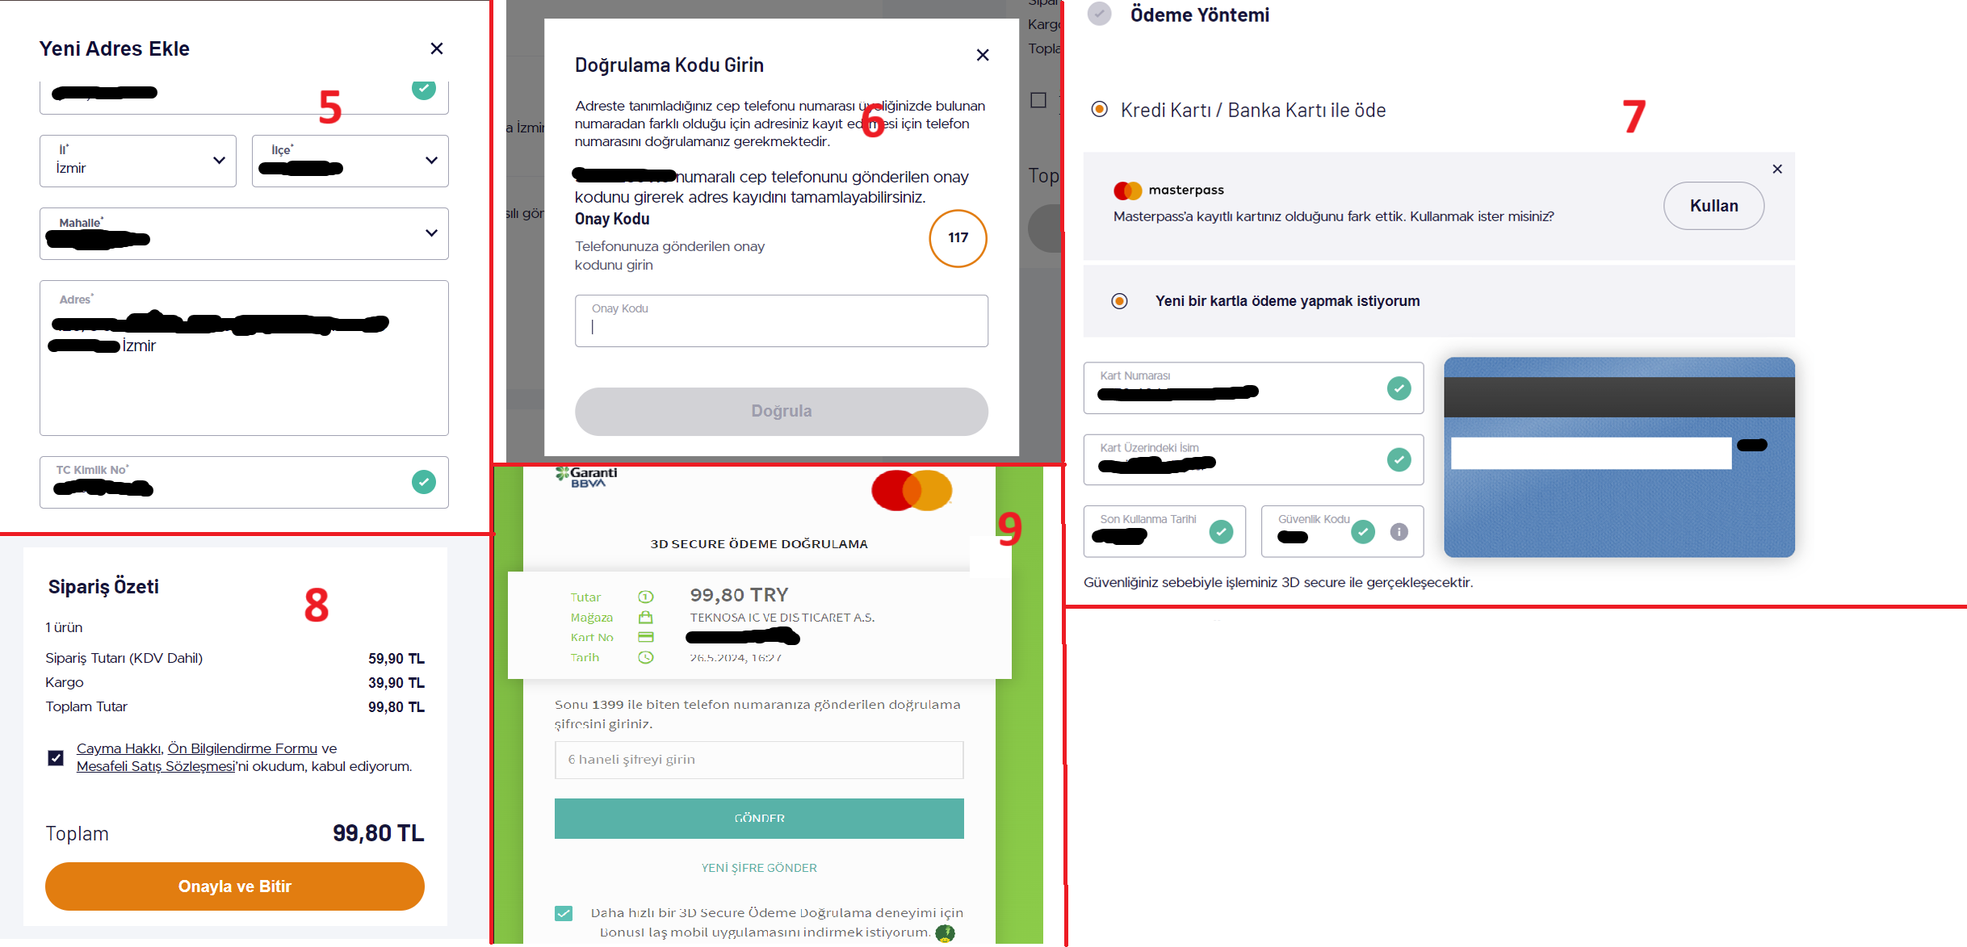
14
Manual Ordering Product Test

Slide 15
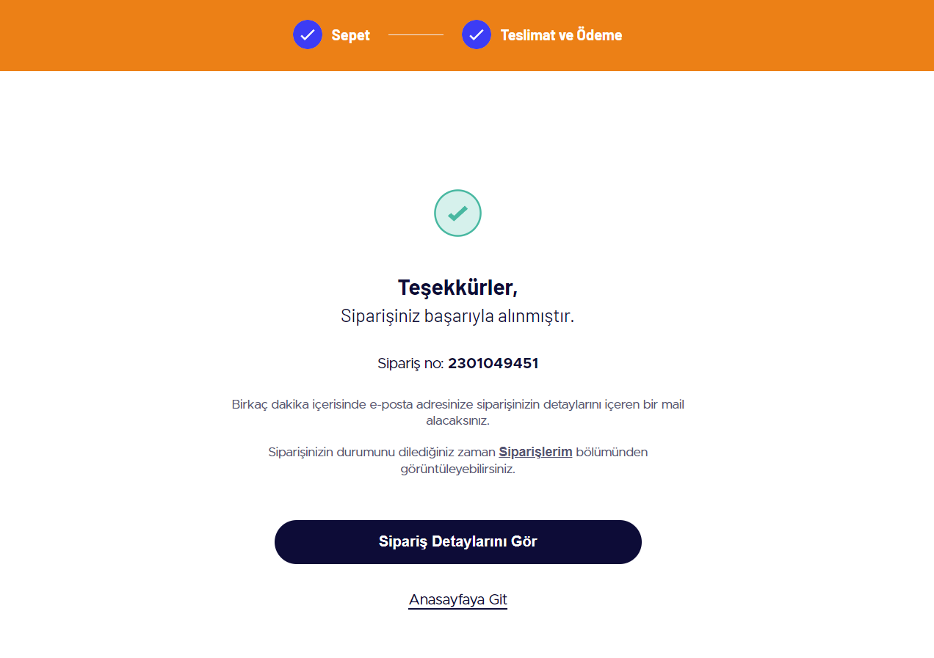
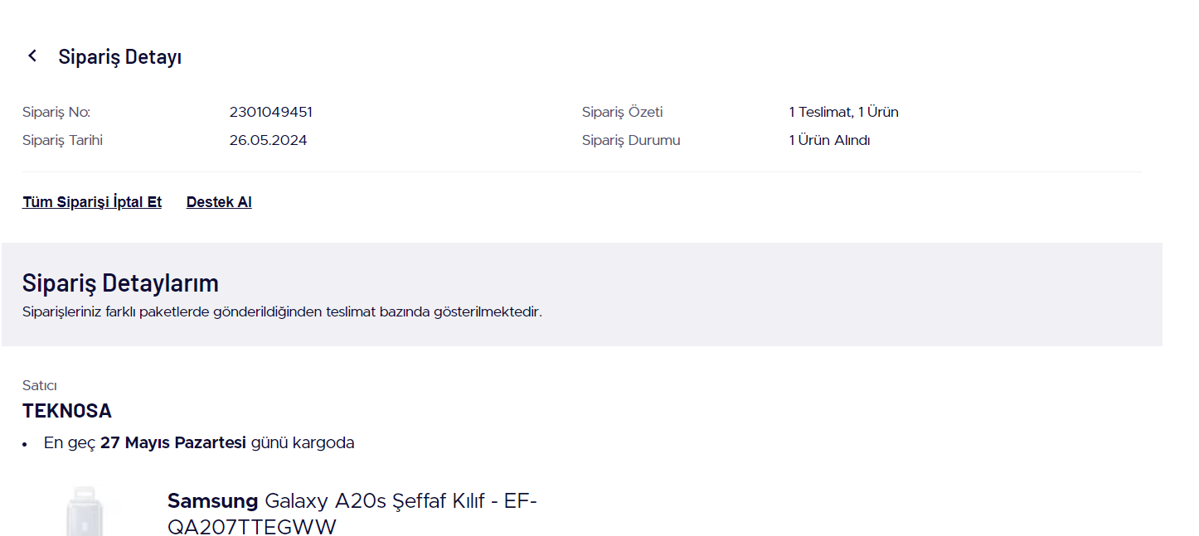
15
Manual Ordering Product Test

Slide 16
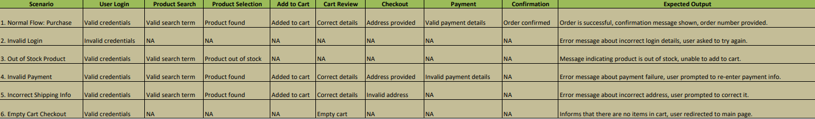
16
Manual Ordering Product Test

Slide 17
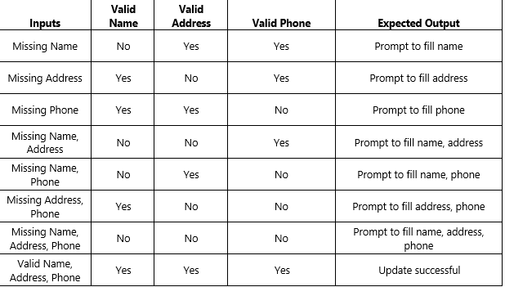
17
Updating Personal Information Test

Slide 18
CONCLUSION
18
There are lots of problems on the filtering part. Although all of the problems shopping cart functions works perfectly.
Compared to other sites, as seen in the performance test, the response times are slightly higher.
As a result of our tests, we obtained a 16% error rate.
The system demonstrates robust stability under normal operating conditions, witj no critical failures or crashes observed during the testing phases.

Slide 19
THANKS FOR LISTENING
19

